Slide 1
Automated Targeting Device
Diploma Project
Student: Petru MUȘAT
Coordinator: Prof. Dr. Ing. Bujor PĂVĂLOIU

Slide 2
01
02
03
INTRODUCTION
COMPONENTS
DEVELOPEMENT
04
05
DEMO
CONCLUSION

Slide 3
01
INTRODUCTION

Slide 4
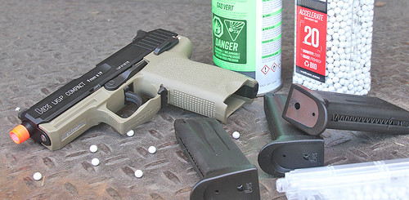
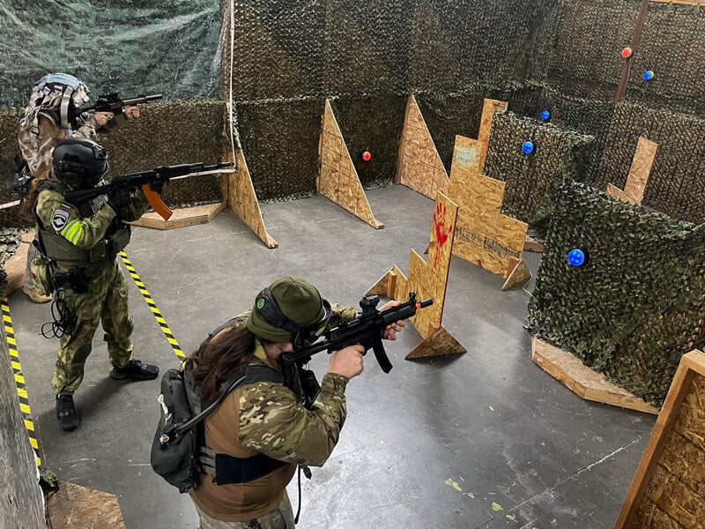
Airsoft does a great job at replicating MilSim situations, but I decided to take it a step even further. The objective of the device is to defend an area without disclosing the user's location.
About the project

Slide 5
COMPONENTS
02

Slide 6
Hardware Component
Microcontroller
Servomotors
Camera
Chassis
Raspberry Pi Pico WH
2 for movement
1 for firing
ESP32-CAM
3D Printed

Slide 7
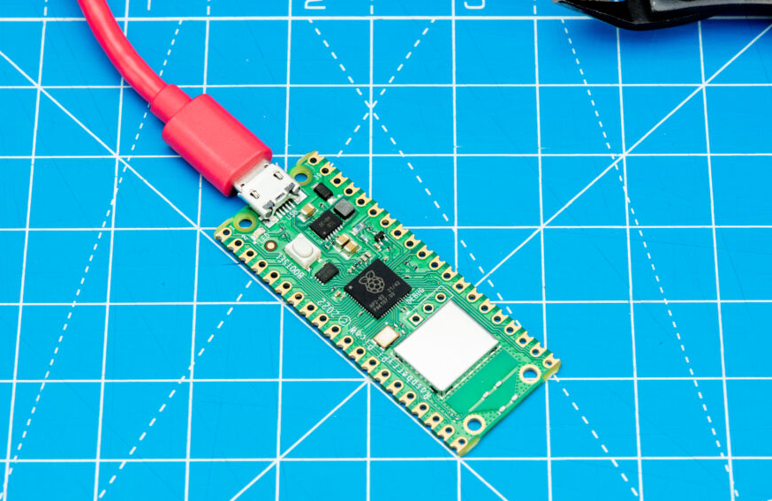
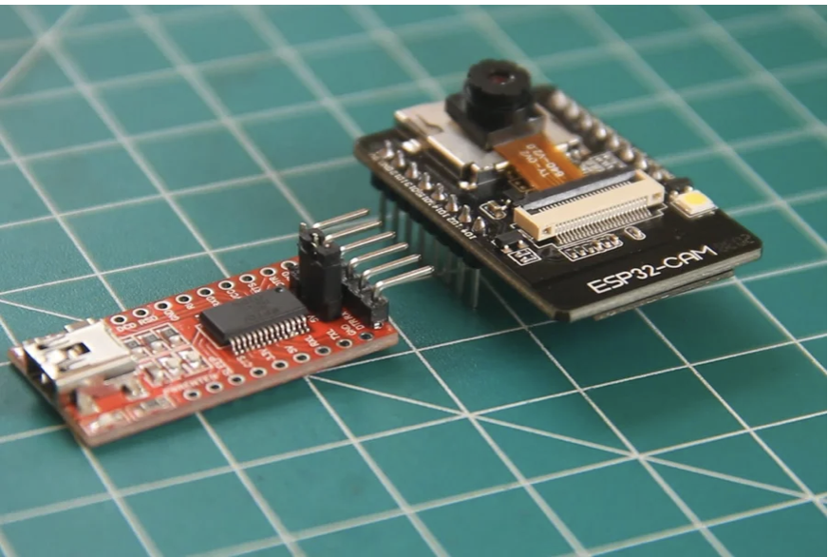
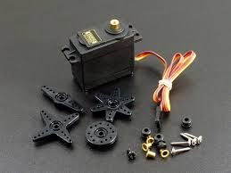
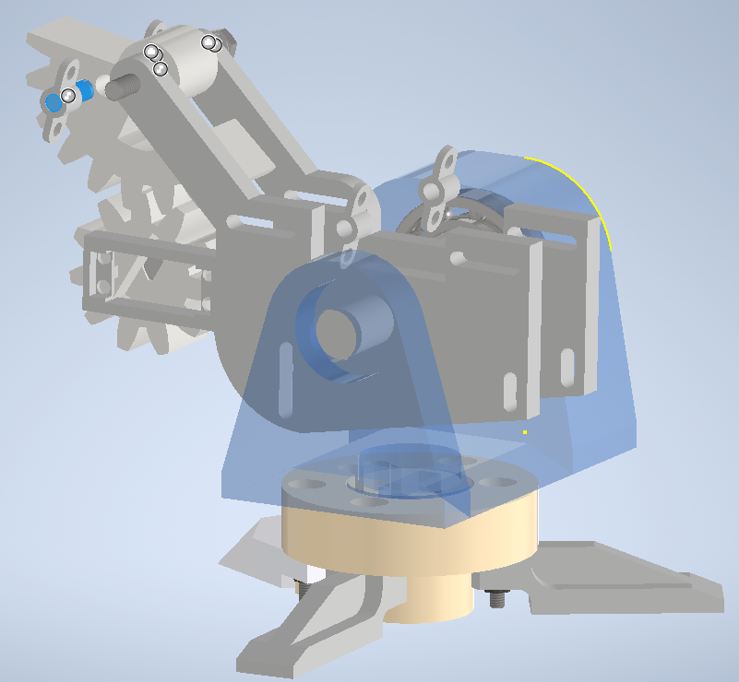
Hardware Component – Images

Slide 8






Software Component
The Mobile Application:
Kotlin
Jetpack Compose
Ktor
The Server:
Java
Spring boot
Programming the Raspberry Pi:
MicroPython

Slide 9
Communication Protocols
WEBSOCKETS
MQTT
SSE
Mobile app
Server
Server
Raspberry Pi
ESP32
Server

Slide 10
03
DEVELOPEMENT

Slide 11
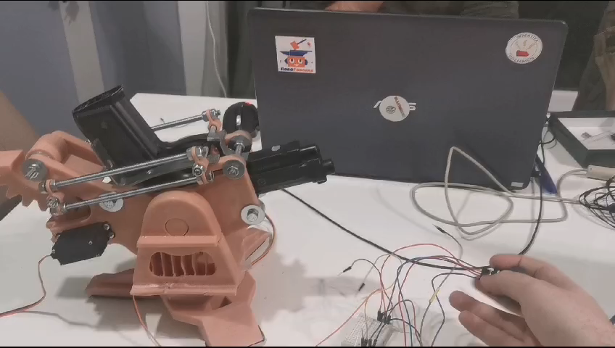
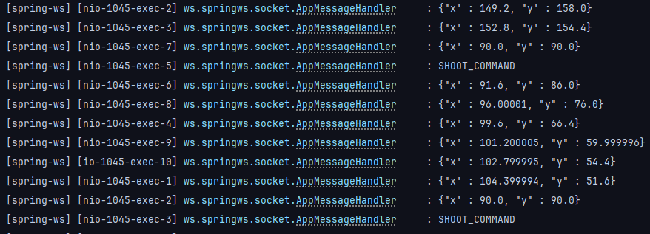
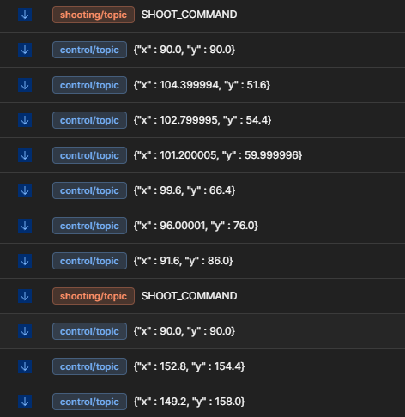
Movement testing
The video to the right showcases testing the servomotors using a joystick.
Communication testing

Slide 12

DEMO TIME

Slide 13
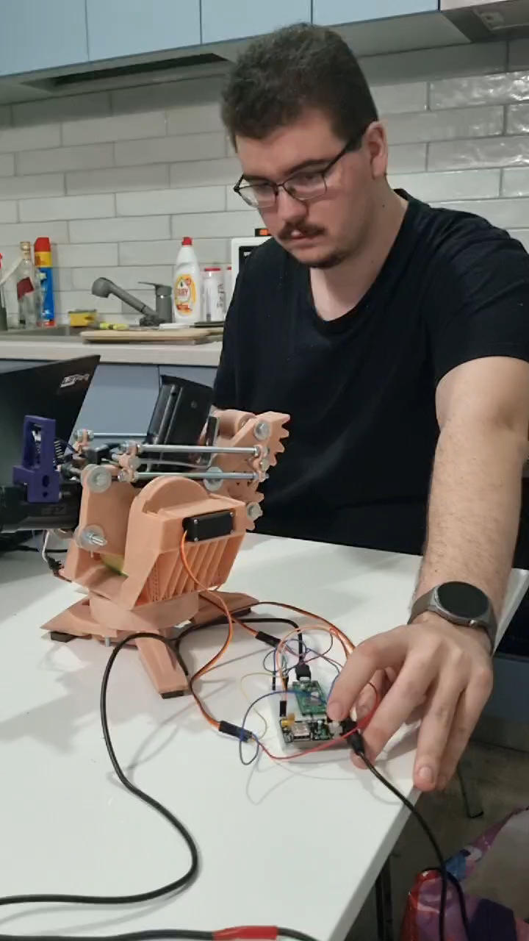
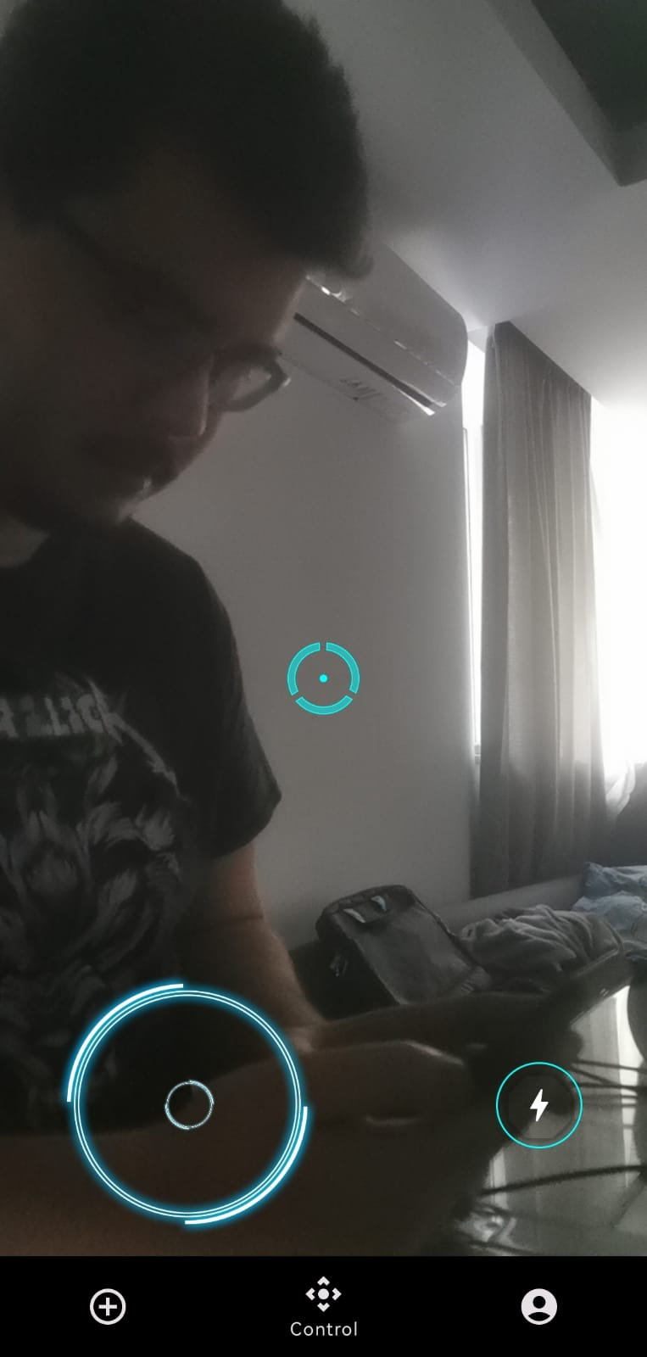
Outside view
Application view

Slide 14
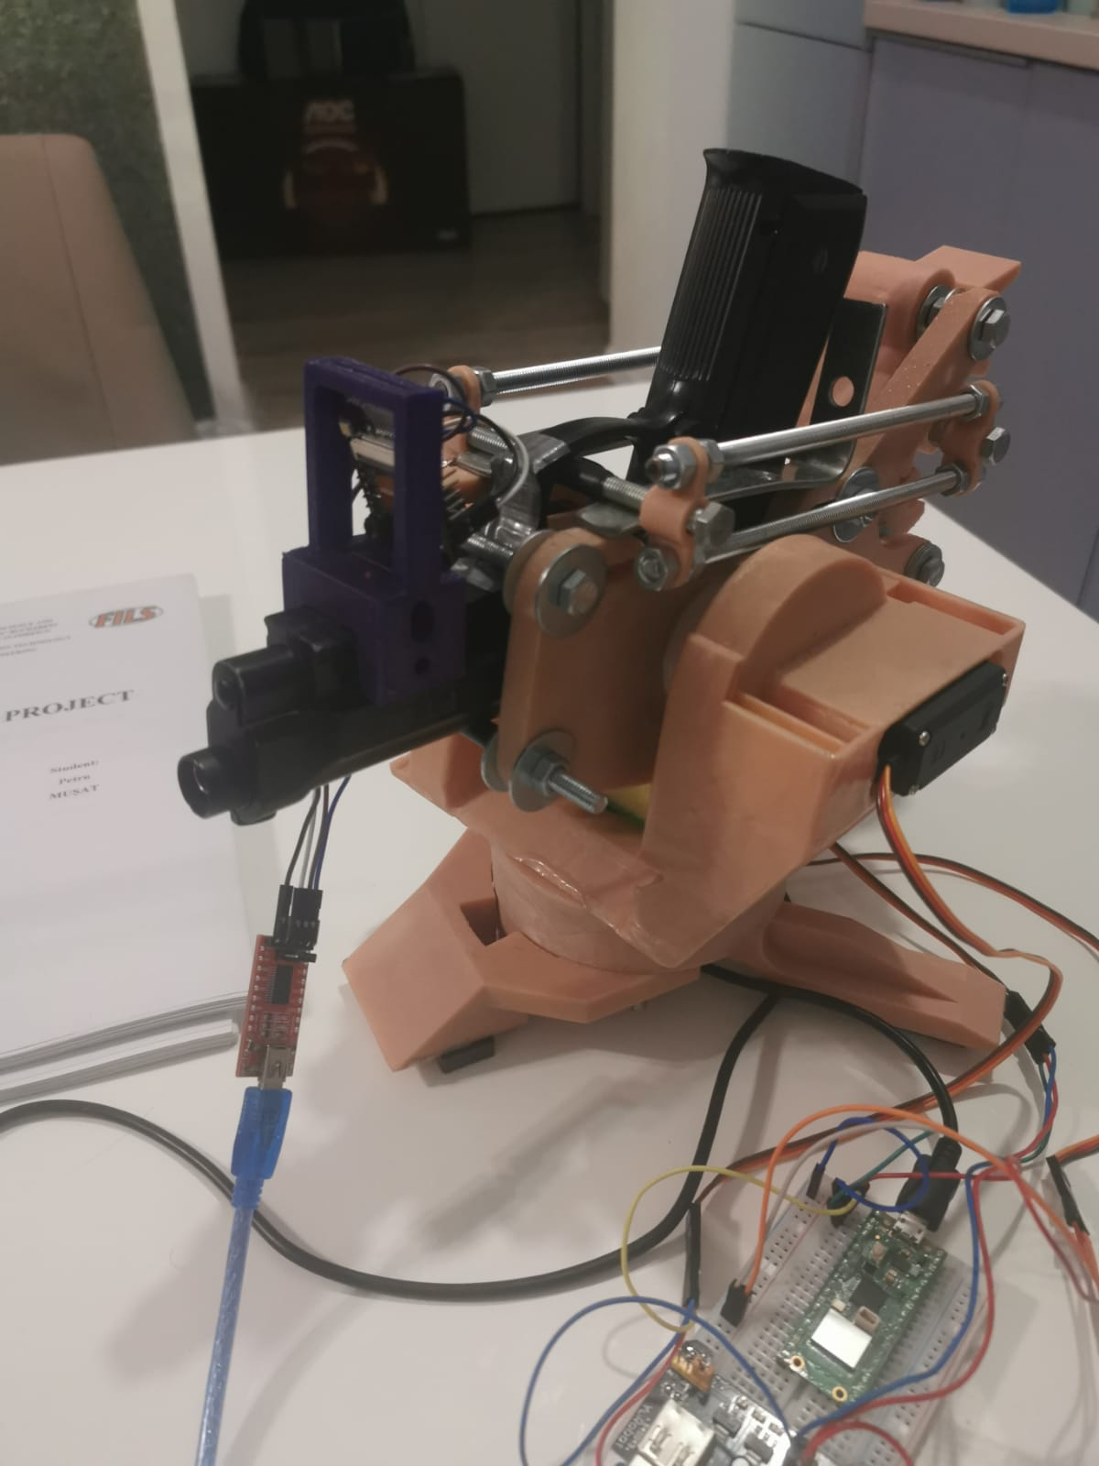
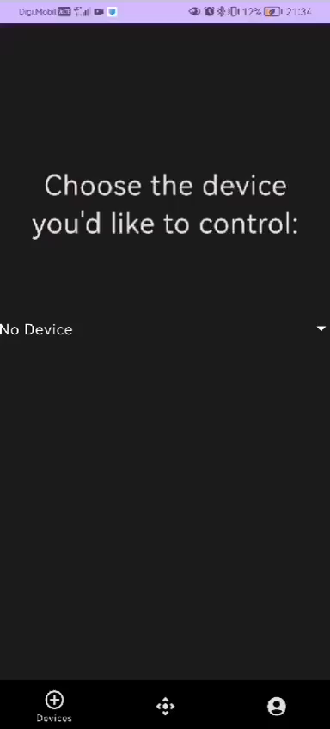
Outside view
Application view

Slide 15
05
CONCLUSION

Slide 16
THANK YOU FOR YOUR ATTENTION!
Any questions?

